Slide 1
Rumor Detection with RNN
2020年6月
范禹 凌邱璇

Slide 2
目录 Contents
1
Introduction
2
Visualization
3
Model
4
Experiments
5
Future Work

Slide 3
目录 Contents
1
Introduction
2
Visualization
3
Model
4
Experiments
5
Future Work

Slide 4
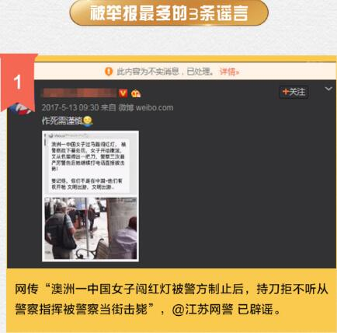
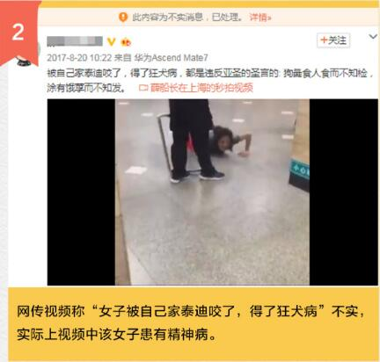
Rumor in Social Platforms
Social platform like Weibo is booming nowadays, while it becomes a prefect place for rumor spreading.
When faced with a dubious claim, people dispute its truthfulness by posting various cues over time, which causes a long-distance dependencies of evidence.

Slide 5
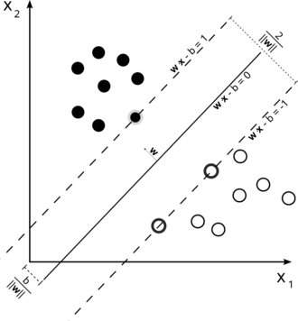
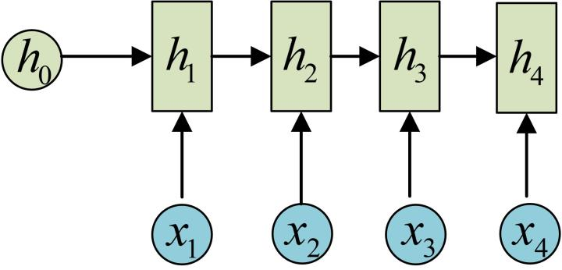
Methods of Rumor Detection
Traditional machine learning method, such as SVM, usually includes many hand-crafted features which require enormous manual effort.
Recurrent neural network has a better ability of learning hidden representation and long-distance dependencies, it’s also easier to extend to other data source.

Slide 6
目录 Contents
1
Introduction
2
Visualization
3
Model
4
Experiments
5
Future Work

Slide 7
目录 Contents
1
Introduction
2
Visualization
3
Model
4
Experiments
5
Future Work

Slide 8
Basic Model
How do we build a RNN model for detecting rumors?
A simple idea:
Model each input instance as an input instance and construct an RNN model with the same number of units.
Problem:
There can be thousands of RNN cell.
Back propagation through a large number of time steps will be time-consuming and may cause gradient vanishing or gradient explosion.
Divide time into certain length slots and treat each time slot, with all posts during that time as a unit?
Problem:
There may be an unbalanced problem: there may be large number of posts in the first several time slots and fewer in other time slots.

Slide 9
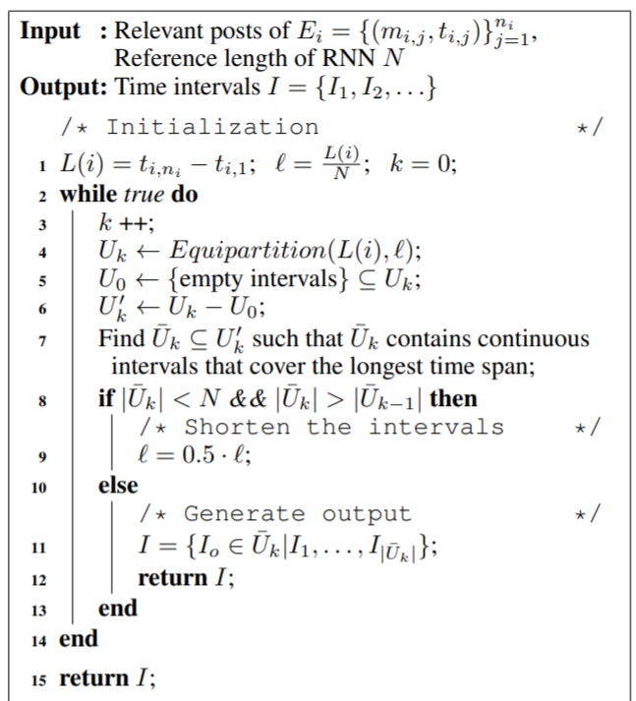
Variable-Length Time Series Algorithm

Slide 10
Basic Model
Can we better utilize the features despite the original text features?
Rumor event always have a different diffusion pattern compared with truth.
Add the diffusion pattern as a new feature.

Slide 11
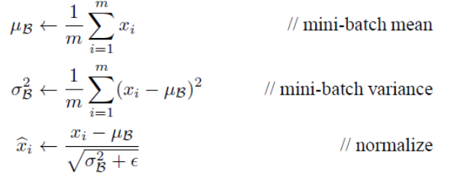
Add diffusion feature
Diffusion Pattern:
An observation: rumor events usually have some boost period, i.e. in a short time related posts increase rapidly.
Inspired by this observation and the idea of batch normalization, we consider utilizing the post time as a new feature about diffusion pattern, and add it together with text features.

Slide 12
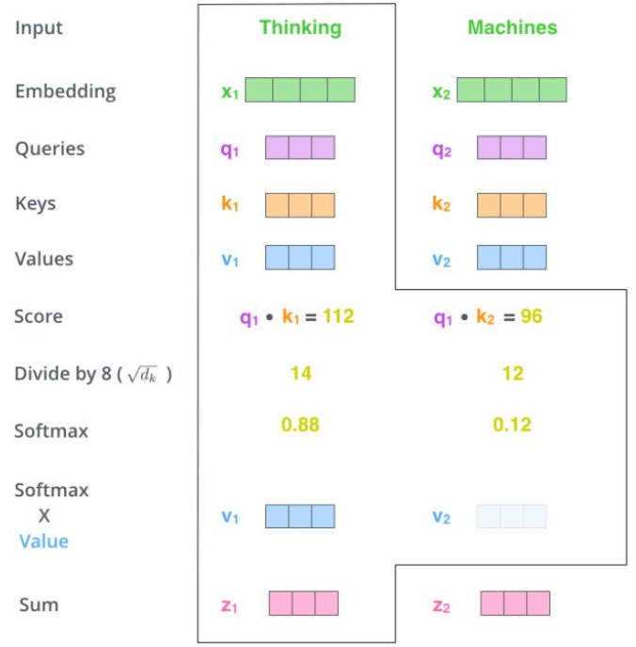
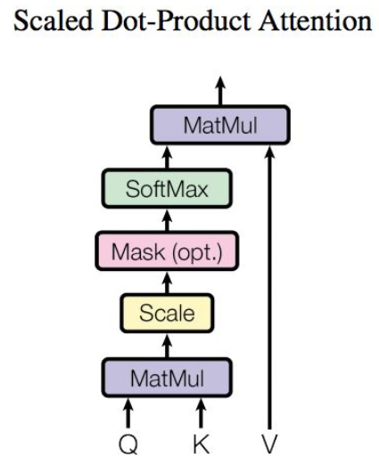
Self-Attention
Attention mechanism is a widely used mechanism in natural language processing, and in our model, we use the self-attention mechanism to improve performance.

Slide 13
Word Embedding
As the corpus of our dataset is small, to better capture word features, we replace our own word embedding with the specific Chinese pretrained word embedding.

Slide 14
Supervised Model
Dense
Dropout
Bidirection LSTM Layer
Self Attention Layer
Bidirection LSTM Layer
Pretrained Word Embedding
Diffusion Feature
Input Instance
Input Instance
Input Instance
Time Feature

Slide 15
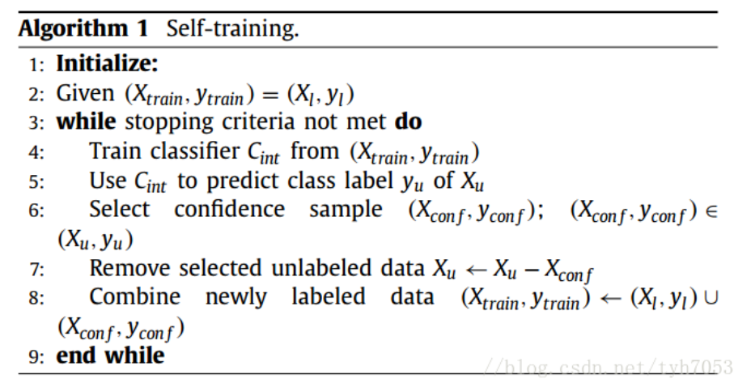
A Semi-Supervised Model
As manual labeled data becomes more and more expensive and unlabeled data is always easy to collect, we also implement a semi-supervised model to utilize the unlabeled data and expands our model’s generalization ability. Core idea is self-training.

Slide 16
目录 Contents
1
Introduction
2
Visualization
3
Model
4
Experiments
5
Future Work

Slide 17
Experiments
Our dataset is from the Sina community management center, which reports misinformation, the dataset includes:
Dataset Information
Users | 2,746,818
Posts | 3,805,656
Events | 4664
Rumors | 2313
No Rumors | 2351
Avg.Time/event | 2460.7h
Avg.Posts/event | 816
Max Posts/event | 59318

Slide 18
Experiments
We implement several traditional machine learning method, a two-layer RNN, and the well-known BERT model as our baseline.
Our supervised model has close performance with the BERT algorithm, and our unsupervised Model also has good performance.
Method | Accuracy
Logistic Regression | 0.538
Random Forest | 0.604
GBDT | 0.616
KNN | 0.578
Two layer RNN | 0.887
BERT | 0.942
Our Model(Supervised) | 0.935
Our Model(Semi-Supervised) | 0.857

Slide 19
目录 Contents
1
Introduction
2
Visualization
3
Model
4
Experiments
5
Conclusion and Future Work

Slide 20
Contribution
Our contribution can be summarized as following:
First, we implement the Variable Time Series Algorithm to divide the posts of single event into several time slots.
Second, we consider the different diffusion pattern of rumor and non-rumor events and add additional time features with the text features.
Third, we utilize self-attention mechanism and pretrained word embedding to help improve our model performance.
Forth, we propose a semi-supervised model, based on the self-training algorithm, to alleviate the problem of the lack of labeled data. And both the supervised model and unsupervised model have good performance.

Slide 21
Future Work
Using the time features of posts to indicate the diffusion pattern is not enough, and the graph-convolution-network(GCN) has a better ability to capture such feature.
More algorithms about semi-supervised can be used to improve the model’s performance, such as co-training, tri-training and so on.
Workload:
Visualization, baseline design and model design: 凌邱璇
Model design: 范禹

Slide 22
谢谢！

